Slide 2
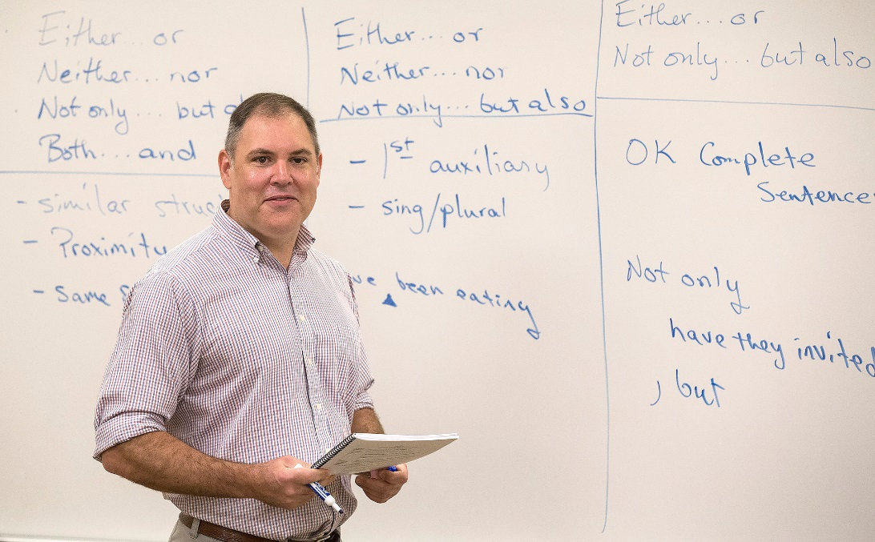
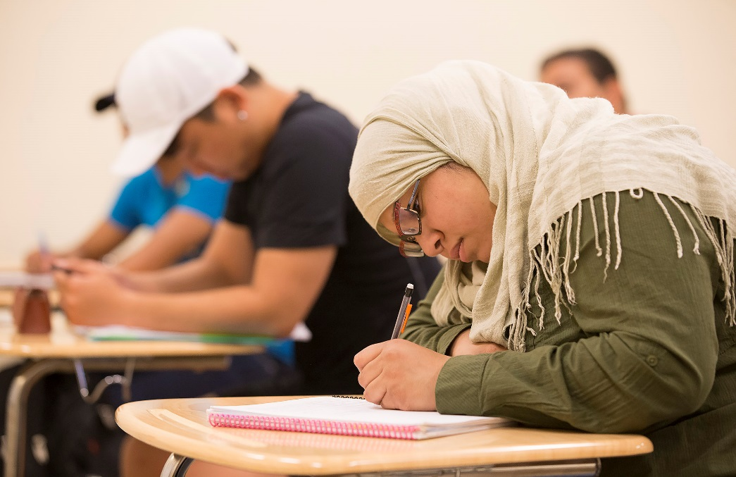
Valdosta State University offers the best of both worlds — the extensive academic, cultural, and social opportunities of a major university and the small classes and close personal attention found at smaller institutions.
About Valdosta State

Slide 3
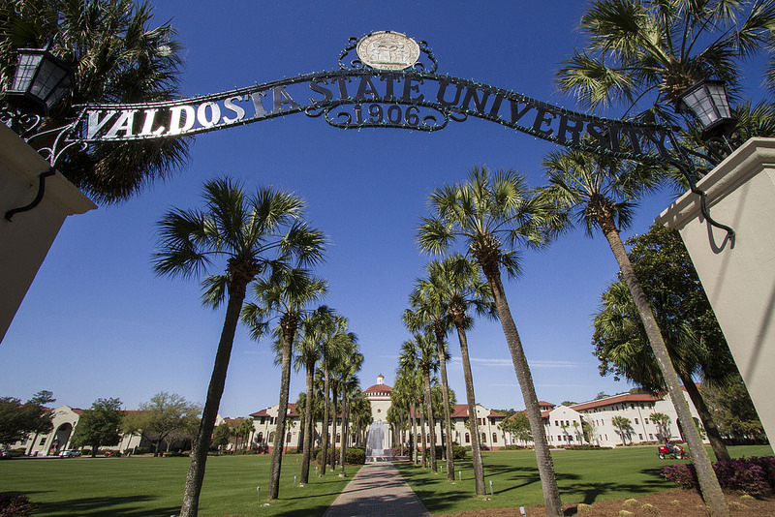
VSU is ranked one of the top 100 Regional Universities in the south and was ranked among the best colleges and universities in the nation when it comes to distance education, according to U.S. News and World Report’s 2016 Best Online Programs rankings.

Slide 4
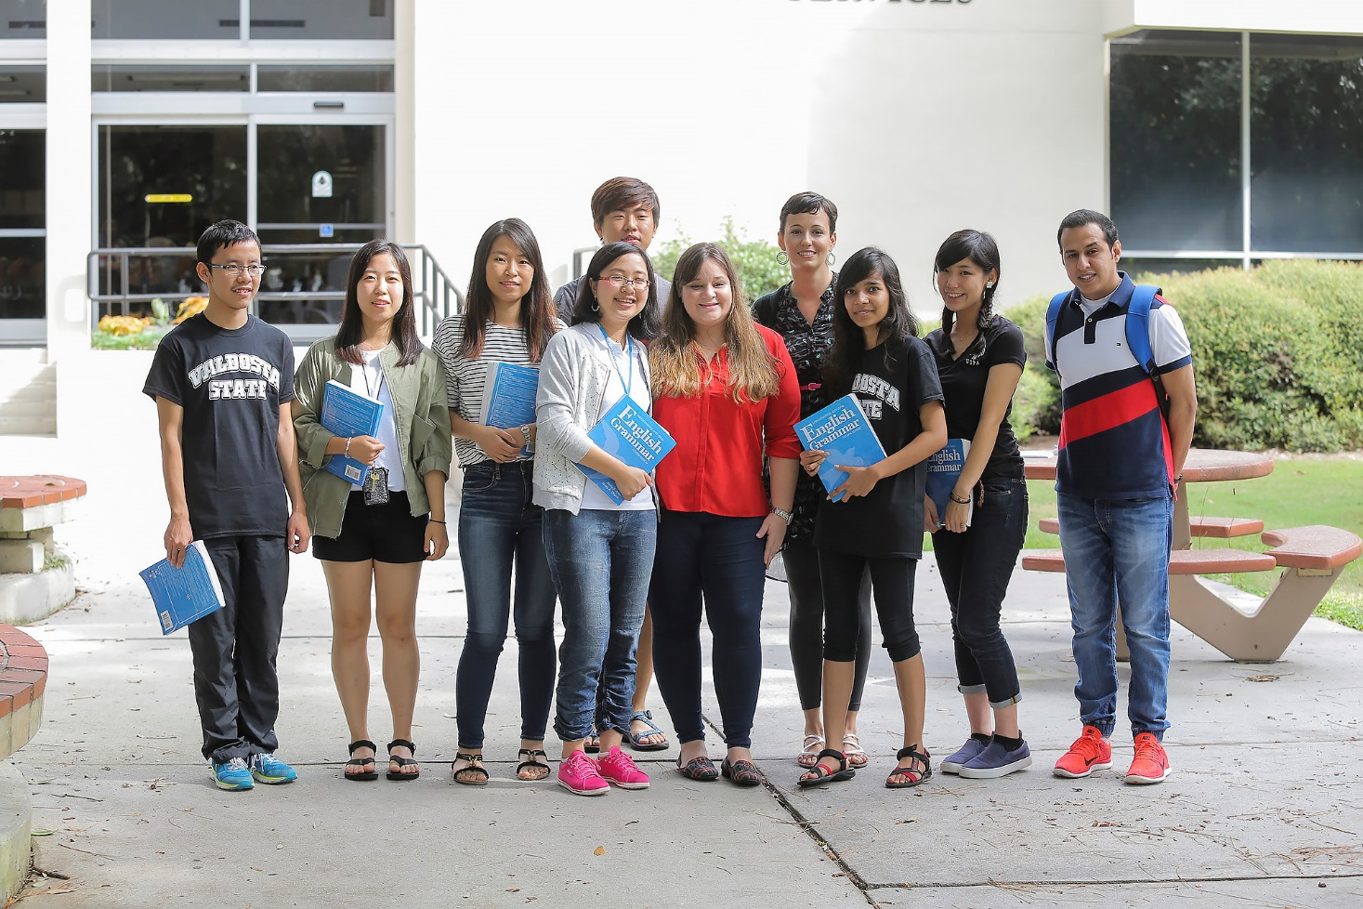
At VSU, undergraduate and graduate students alike actively engage in scholarly activities with faculty members, providing opportunities for students to conduct research directly related to their selected discipline.
Academic Excellence

Slide 5
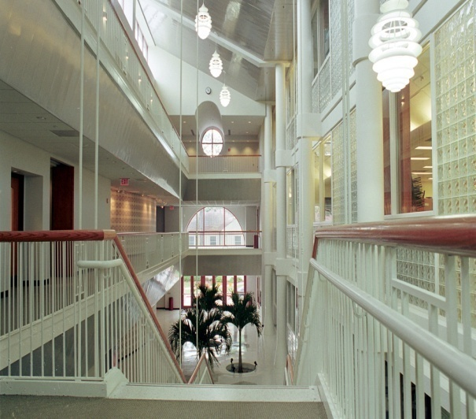
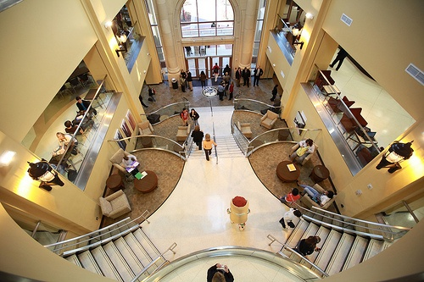
Academics
Undergraduate Level :
Five colleges: Arts, Arts & Sciences, Business Administration, Education and Nursing
Comprehensive curriculum includes over 100 degree programs
The largest majors are Biology, Business, Computer Science, Marketing, Pre-Engineering, Nursing
English Language Institute with intensive language programs

Slide 6
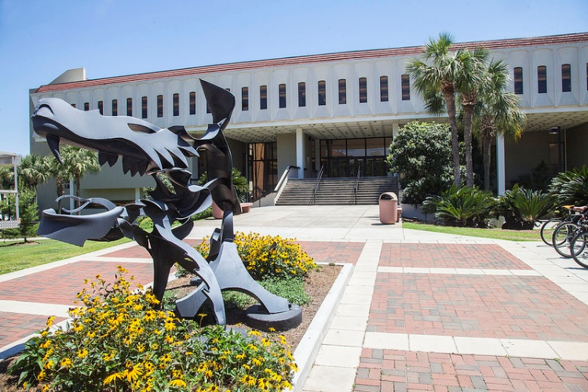
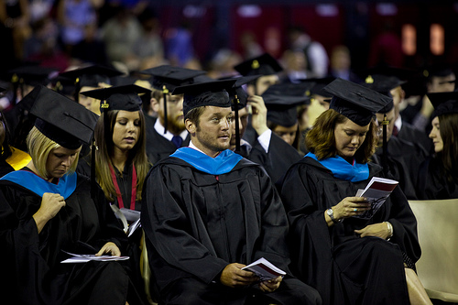
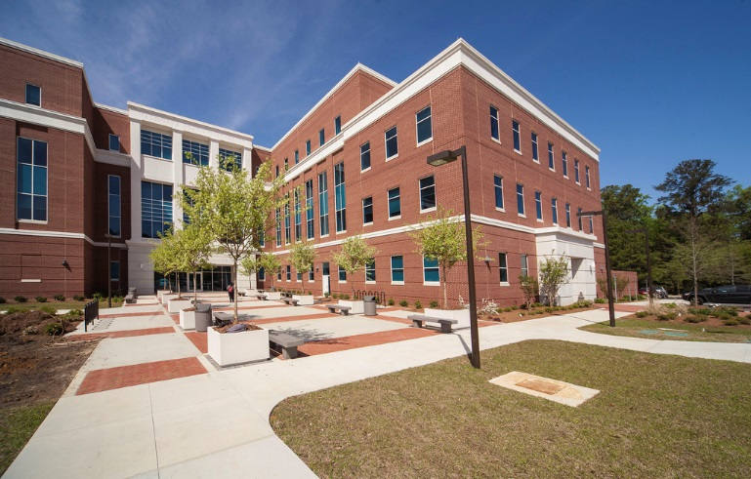
Academics
Graduate Level Programs:
Masters level: 14 programs with over 40 degrees, including MBA
Doctoral Level: 2 programs with 4 degrees offered
Accreditation:
All programs at the University are fully accredited academically and professionally
Examples:
The College of Business Administration is accredited by AACSB International, one of the most respected business school accreditations in the world. This accreditation places our undergraduate and graduate (MBA and Web MBA) programs in the top 5 % internationally;
Both the bachelor’s degree (BSN) and the master’s degree (MSN) programs in the College of Nursing are accredited by the Commission on Collegiate Nursing Education

Slide 7
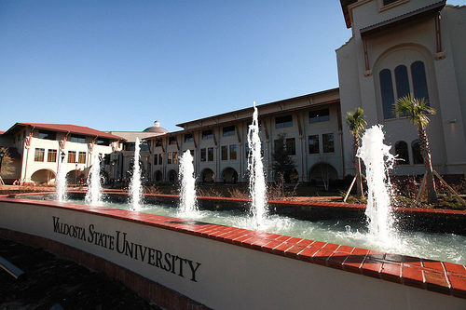
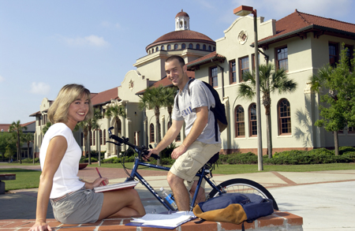
Why Choose the ELI at VSU?
Academic Excellence
Student Centered Teaching & Learning
Culturally Sensitive, Welcoming Campus & Great Climate
Rich Student Life
Low cost of living

Slide 8
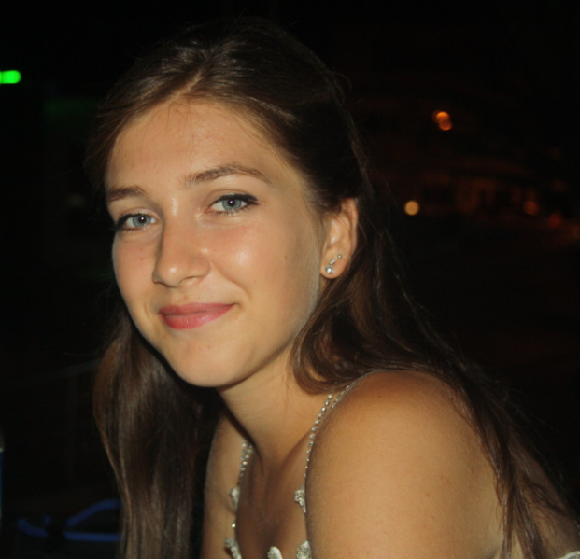
“I came to ELI from Turkey. When I graduated from university, I began considering options for developing my English language skills, and this university was my top preference because I heard a lot of good things about both the teachers and the environment. I am certainly pleased that I came here. Teachers are really good, helpful, and friendly. I made a lot of friends from other countries here at ELI. In addition, the activities organized and offered here, most definitely have helped me improve my language. If you also want to improve your English in another country, VSU is a good choice.”
Derya Keskin| ELI Student| Istanbul, Turkey

Slide 9
“I studied at the ELI for one year, so I enjoyed this place and I was very happy with my teachers and also with all the friends I made. I was lucky to be able to have studied here.”
Saud Almanjumi | ELI Graduate | Taif, Saudi Arabia

Slide 10
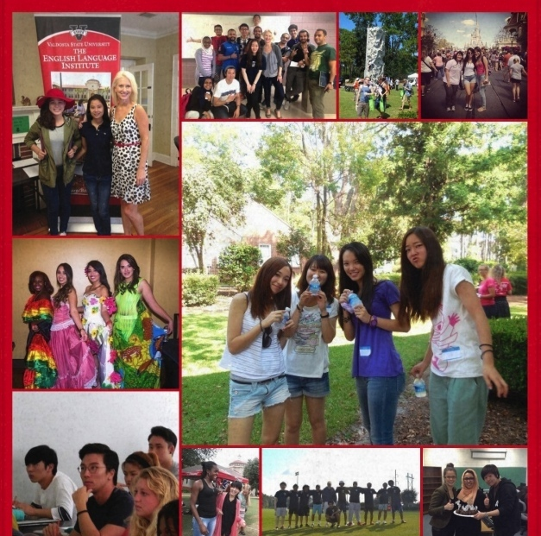
ENGLISH LANGUAGE INSTITUTE YOUR PATHWAY TO VALDOSTA STATE UNIVERSITY
Excellent Academic Preparation. ELI graduates from Level 6 with a B average or higher qualify for admission to VSU without a TOEFL or IELTS score.
Convenient Start Dates: August, October, January, March, May, & June. Placement testing upon arrival
Six levels of instruction in Reading and Writing, Grammar, and Conversation
Conditional Admissions- students begin their studies at ELI and easily transition to VSU. ELI staff helps with paperwork.

Slide 11
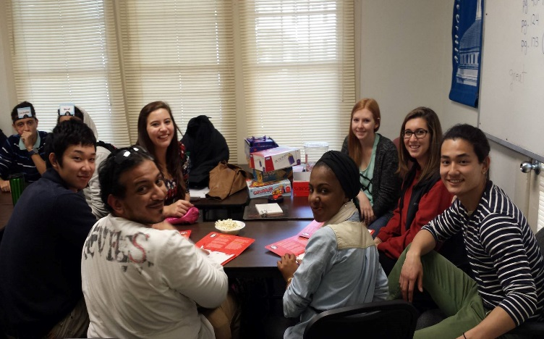
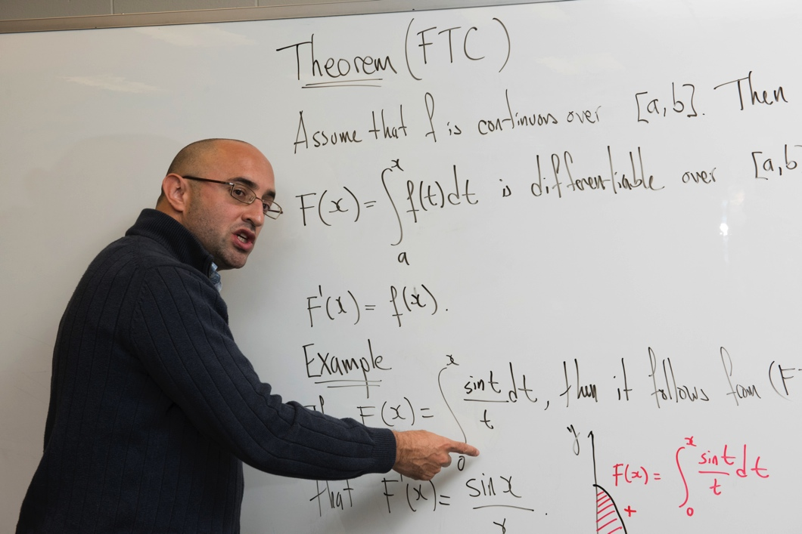
ENGLISH LANGUAGE INSTITUTE YOUR PATHWAY TO VALDOSTA STATE UNIVERSITY
Our classes are small and interactive, and our teachers are dedicated to students’ success, so they experience rapid improvement in their English skills.
If students need extra help, we offer free tutoring and TOEFL preparation classes when requested.
Students have many opportunities to learn about American culture and make new friends in our conversation program and afternoon and weekend activities.
ELI classes are on the VSU campus, and ELI students have access to all the university has to offer.

Slide 12
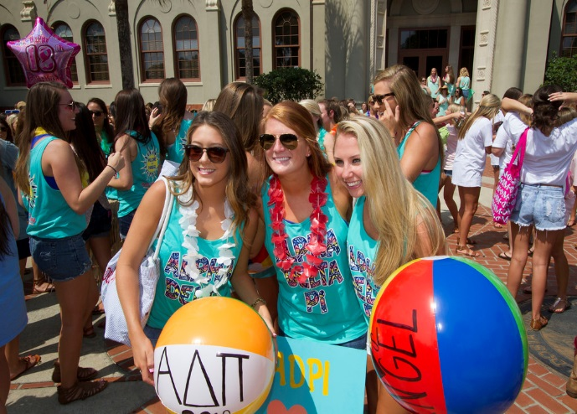
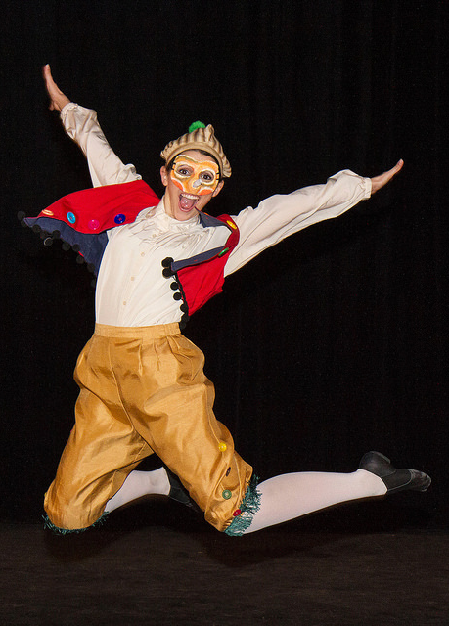
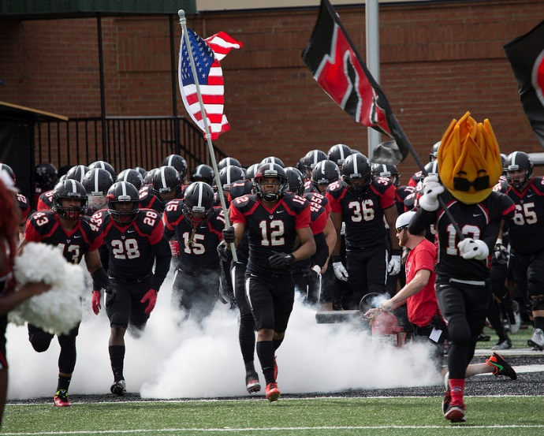
Campus Environment
Student Life:
VSU campus has 9 residence halls, many of which are available year round;
Housing facilities range from modest to luxurious apartments.
12 Dining Options
190+ Student Organizations
25 Fraternities and Sororities
12 NCAA Division II Sport Teams
24- hour Campus Police Protection

Slide 13
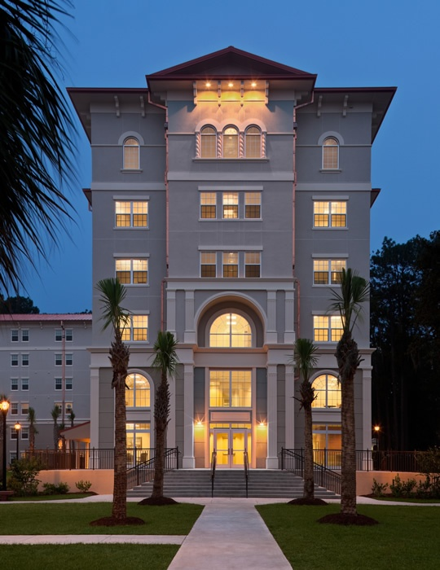
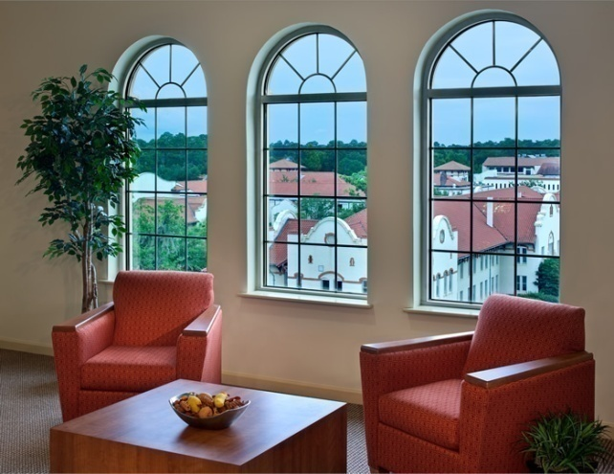
On-Campus Housing
Housing
Living on campus is a great way to make new friends and get to know VSU.
On-site staff provide support and apartment-style residence halls are available to international students.
Most Dormitory Halls are open during all holidays & breaks.
Students who live on campus must purchase a meal plan.

Slide 14
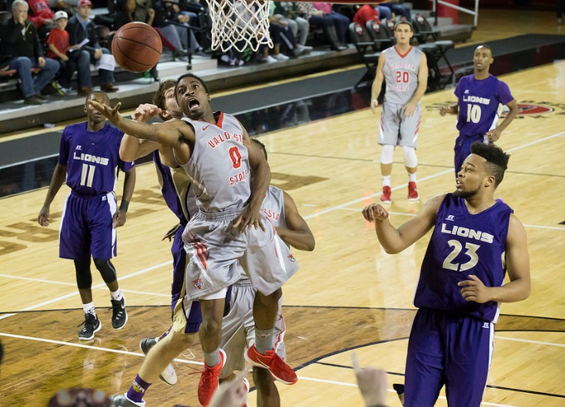
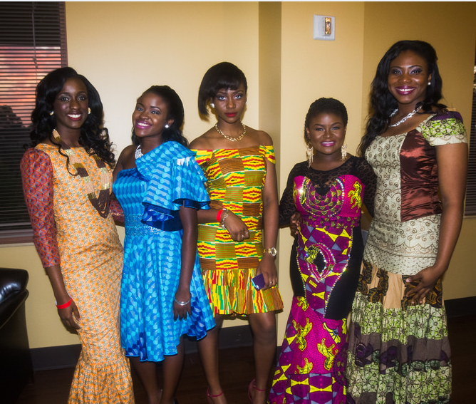
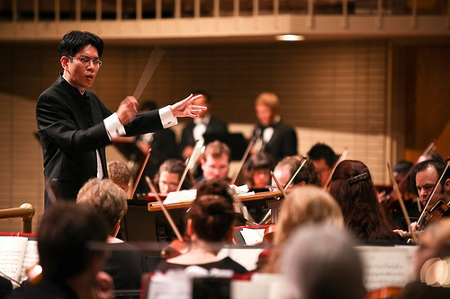
Student Life
Students can become involved in over 190 various clubs and organizations which will aid their academic and personal development
SIS (Society of International Students)
SIFE (Students In Free Enterprise) an international network of students, academics and business leaders.
Honors Students Association
Beta Alpha Psi (Accounting and Finance)
Jazz Ensemble

Slide 15
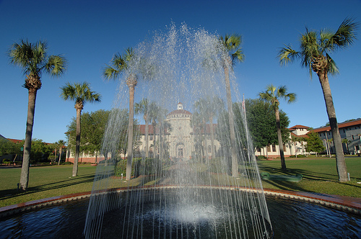
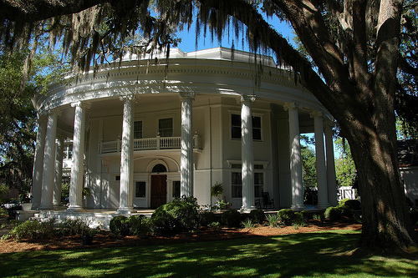
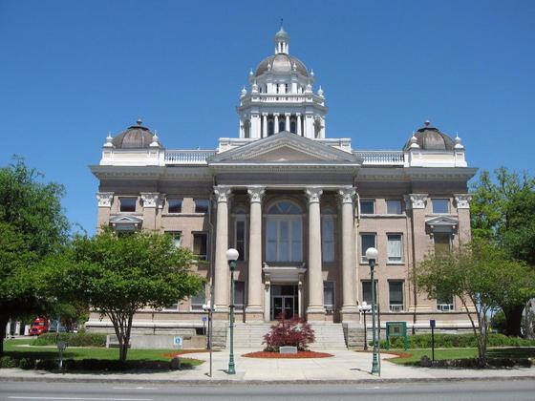
Our Location and Travel
Location:
Valdosta is located in South Georgia near the Florida border on I-75, a short trip away from coastal resorts
The fifth largest urban area in Georgia with multiple cultural opportunities
Spanish Mission-style campus, nationally recognized for its beauty

